Slide 1
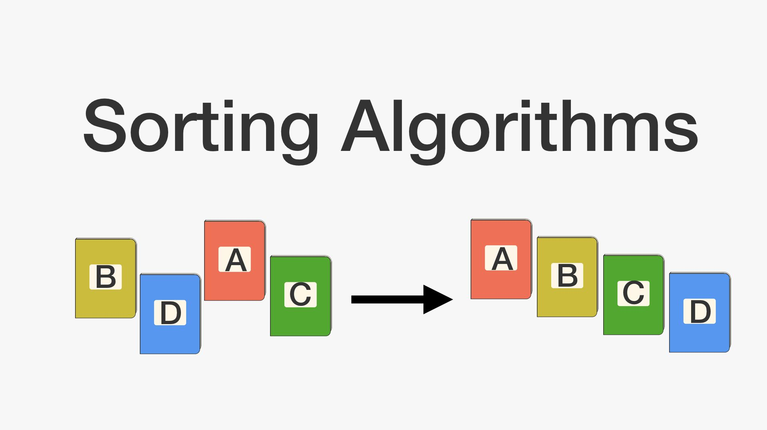
Sorting:
Presented by : Bhuwan Dhakal

Slide 2
SORTING: EXAMPLES OF SORTING: TYPES OF SORTING:
Sorting is the process of ordering elements in an array in specific order e.g ascending or descending ,it can be done based on key references which can be numbers, alphabets etc.
Examples:
1.Words in a dictionary are sorted
2.Files in a directory
3.Index of a book
Types:
1.Internal
2.external

Slide 3
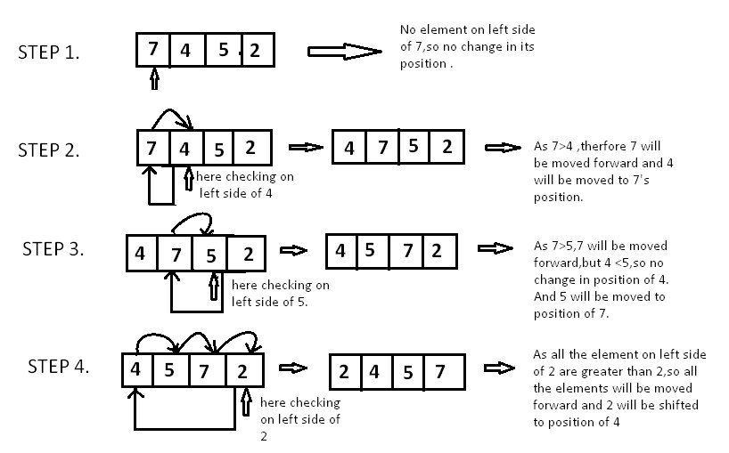
Insertion sort:
Step 1 − If the element is the first one, it is already sorted.
Step 2 – Move to next element
Step 3 − Compare the current element with all elements in the sorted array
Step 4 – If the element in the sorted array is smaller than the current element, iterate to the next element. Otherwise, shift all the greater element in the array by one position towards the right
Step 5 − Insert the value at the correct position
Step 6 − Repeat until the complete list is sorted

Slide 4
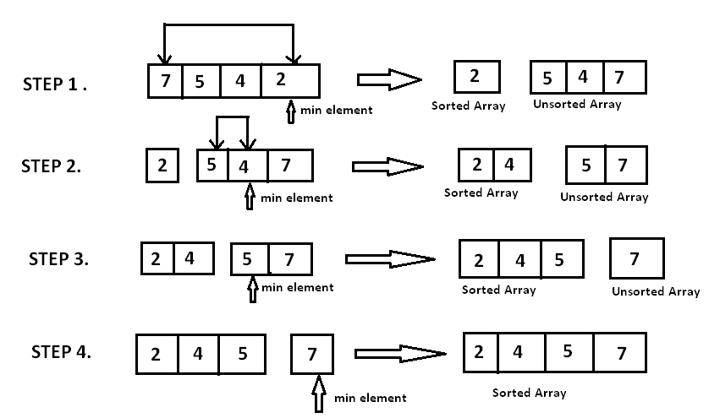
Selection sort:
Step 1 − Set min to the first location
Step 2 − Search the minimum element in the array
Step 3 – swap the first location with the minimum value in the array
Step 4 – assign the second element as min.
Step 5 − Repeat the process until we get a sorted array.

Slide 5
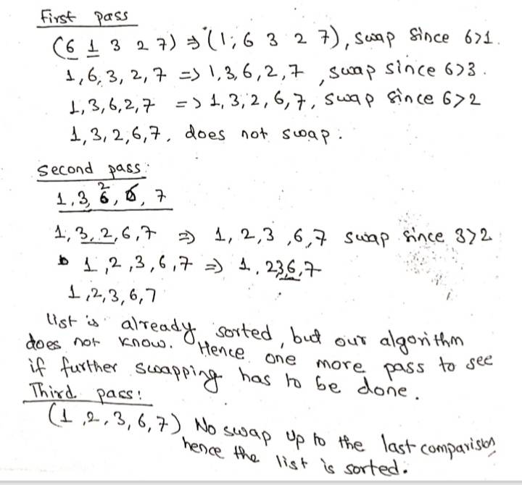
Bubble sort:
1.In pass1,[A0] and [A1] are compared ,then [A1] is compared with [A2],[A2] is compared with [A3] and so on finally A[n-2]is compared with A[n-1].It places biggest element in the highest index of array.
Pass2:
[A0 ]and [A1] are compared ,then [A1] is compared with [A2],[A2] is compared with [A3 ]and so on. Finally A[n-3] is compared with A[n-2].Pass 2 involves the [n-2] comparisons and places the second biggest element at the second highest index of array.

Slide 6
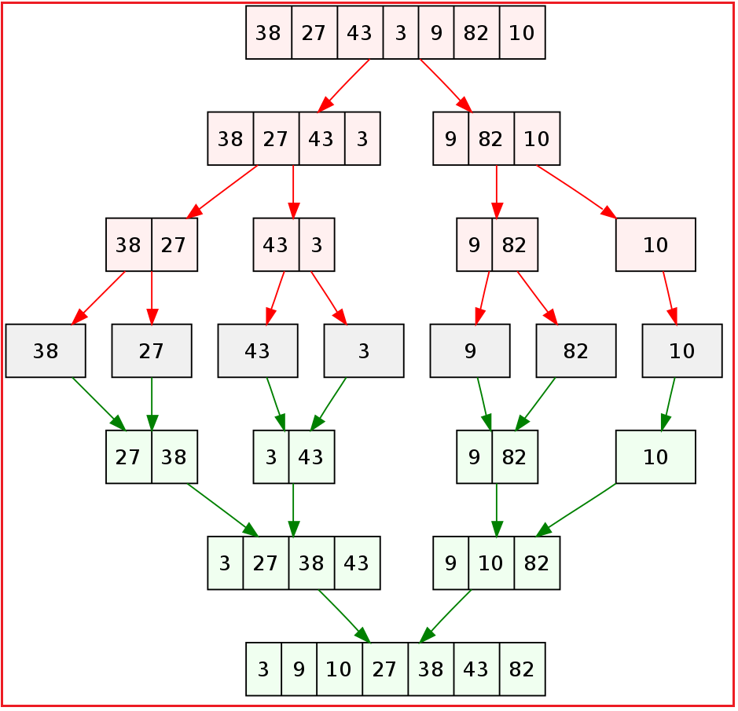
Merge sort:
Divide and conquer :To solve a hard problem , break it down into two or more easier sub problems solve these sub problems seperately and combine the answers.
1.At first we divide the given list of items .
List is divided into two part(almost half )
The process is repeated until each sub list contain exactly one item.
2.Sort and conquer :
A list with single element is considered to be sorted automatically.
Pair of list is sorted and merged into one.
The sort and merge is kept repeated until a single list of size n is found.

